Slide 1
MILITARY BRIEFING FUNDAMENTALS

Slide 2
LEARNING OBJECTIVES
Describe the types of military intelligence briefings and their purpose.
Apply the steps for creating and presenting an intelligence briefing.
Recognize common errors in briefing.
“Just twelve minutes in front of the right audience can be worth more than a whole year behind your desk.” - Anonymous

Slide 3
Comms Is Most Effective When It Is …
Clear
Coherent
Convincing
Complete
Concise
Correct
Credible
Controlled
AND
when the RECEIVER …
HEARS AND UNDERSTANDS

Slide 4
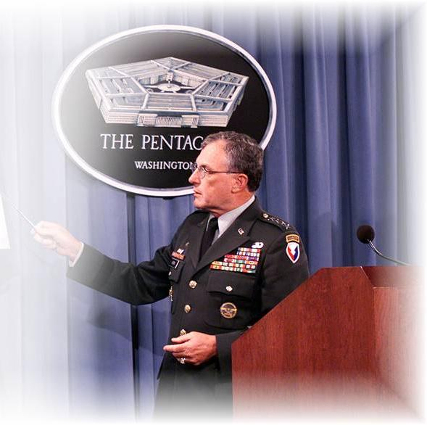
Purpose of Intelligence Briefs
Briefs disseminate intelligence quickly
Right info, right time, right format
Summarized intelligence picture in clear, concise manner

Slide 5
Types Of Military Briefings
Information
Decision
Mission
Staff

Slide 6
INFORMATION BRIEFING
Used to brief primary facts
When:
High priority information requiring immediate attention
Great amount of information to brief
Complex information/plans
Systems and statistics
Conclusions/ recommendations not included in brief

Slide 7
INFORMATION BRIEF FORMAT
Greeting
Type and Classification
Purpose and Scope
I will cover the operations plan for Field Training Exercise “Team Spirit”
Outline or Procedure
Body
Closing

Slide 8
DECISION BRIEFING
Used to obtain a decision
Obtains an answer to a question or results in a decision on a course of action
Presents the recommended solution resulting from analysis or study of a problem or problem area
Vary in formality and detail, depending on the level of command and the decision makers’ knowledge of the subject

Slide 9
DECISION BRIEF FORMAT
Introduction
Greeting
Type, classification and purpose of briefing
Statement of problem
Recommendation
Body
Courses of Action
Analysis
Comparison
Conclusion
Questions
Restatement of Recommendation
Request a Decision

Slide 10
MISSION BRIEFING
Used in operations to:
Impart information
Give specific instructions
Instill appreciation of mission

Slide 11
MISSION BRIEF FORMAT
A mission briefing often follows the five-paragraph operation order format:
Situation
Mission
Execution
Sustainment/CSS
Command and signal

Slide 12
STAFF BRIEFING
Used to coordinate effort for:
Exchange of information
Announcement of decisions
Held on regular basis at set times

Slide 13
STAFF BRIEFING FORMAT
Common Procedures
The person who convenes the staff briefing sets the agenda
The chief of staff or executive officer normally presides
Each staff representative presents information on his particular area
The commander usually concludes the briefing but may take an active part throughout the presentation

Slide 14
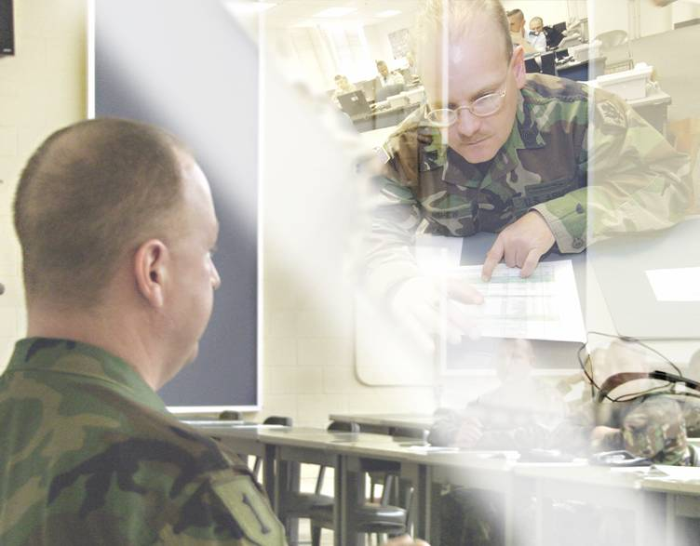
Procedure For Developing a Brief
Analyze Task
Select & Organize Materials
Write the Brief
Prepare the Graphics
Rehearse the Brief
Present the Brief

Slide 15
STEP 1: ANALYZE TASK
Who?
Number of attendees
Nature of audience
Audience knowledge of subject matter
What?
Purpose of the presentation
Topic
Where?
Facilities
Equipment needed
When?
Time available to prepare
Time available to deliver material

Slide 16
STEP 1: ANALYZE TASK Cont…
How?
Determine requirements for presentation
Audience
Who and how many
High-ranking officials
Knowledge of subject
Personal preferences

Slide 17
STEP 1: ANALYZE TASK Cont…
Purpose and Type
Information Briefing
Mission Briefing
Decision Briefing
Staff Briefing
Subject
Broad
Well-known
Complex

Slide 18
STEP 1: ANALYZE TASK Cont…
Physical Facilities
Location
Arrangement
Visual Aids

Slide 19
STEP 2: SELECT AND ORGANIZE MATERIAL
Research
Collect material
Coordinate with other subject matter experts
Document process

Slide 20
STEP 3: WRITE THE BRIEF
Logical Outline
Introduction
Body
Conclusion

Slide 21
STEP 4: PREPARE GRAPHICS
Legible
Simple
Clear

Slide 22
TEXT
Title
Organization
Topic
Briefer
Classification
Bullets
Simple statements of general information
Short phrases
Talk more, show less
List
General information conveyed in a sequence
Briefing Techniques
Major Pain
Overall Classification:
Unclassified

Slide 23
Text
Colors
or
Contrast is key, group or differentiate
Bright versus Dull
Fonts: Style and Size
Underline or italics
Bullets vs. complete sentences
Write for the eye
Light on dark
Dark on light

Slide 24
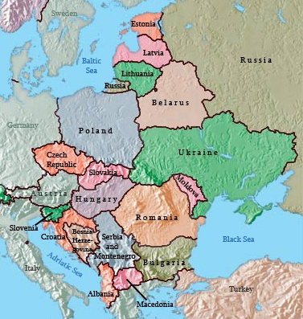
TEXT ERRORS
Misspelllings cAsE Alignment
Irrelevant
Visibility too small
Text that overlays graphics or pictures
Mixed Fonts
Clutter: An example of clutter would be this paragraph here. Having too much information on your slides will take away from your brief. If you are going to put everything you say on the slide, what is the point in briefing it? Just print the presentation out, hand it to your audience and have them read it. You will build no credibility this way.
Crooked

Slide 25
APPEARANCE
A busy background will distract attention from your message
Keep the background simple with pictures that add to what you are saying
You do not want people to leave the briefing remembering ONLY your funny clip-art

Slide 26
VISUAL AIDS
Maps and charts
Models and diagrams
Imagery and photos
Videos and films
Slides
Others…?

Slide 27
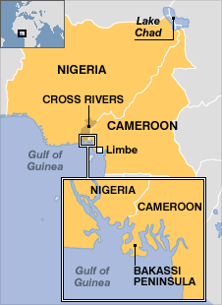
MAPS
Identify relevance
Provide context for map
Highlight key point
Choose scale carefully
Mission v. degree of detail

Slide 28
Models and Diagrams
Illustrate complex ideas in simple terms
Breakdown of:
Organizations structure and components
General process
Key factors
Simple design and message
Due to natural complexity, use sparingly
Sgt Kesho
Cpl Alpha
Cpl Bravo
Cpl Charlie

Slide 29
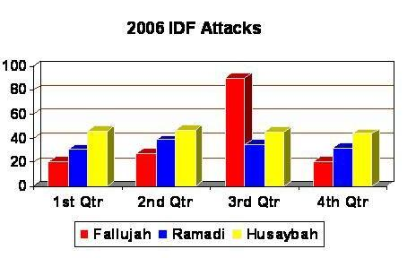
Vertical Bar Chart
Uses time and amount axis to compare data over time
Compare / contrast data between one time period and another
Emphasize the amount of data in one series rather than a trend
Compare data from two or more series

Slide 30
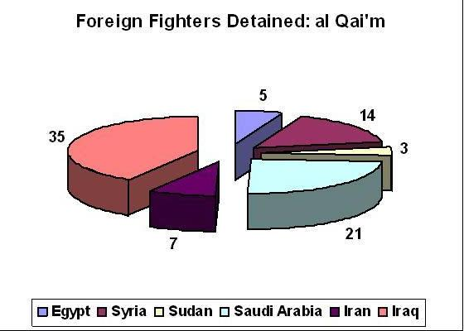
Pie Chart
Break down a single data series
Show percentage portions
Emphasize contribution of one piece of data to the whole

Slide 31
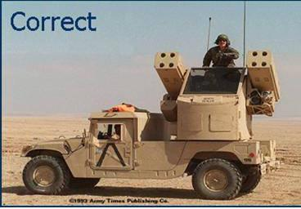
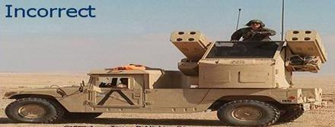
Graphic Errors
Distortion
Clutter
Missing labels

Slide 32
Step 5: Rehearse the Brief
Overcome fear and anxiety
Control nerves
“Murder board” methods
Small, critical audience
Constructive criticism

Slide 33
Step 6: Present the Brief
Articulate
Project competence and credibility
Poor speaking skills destroy credible, accurate analysis
Prepare the briefing area

Slide 34
Step 6: Present the Brief Cont…
Gain the audience’s attention
Provide an introduction
Deliver the brief
Conclude the brief
Call for questions

Slide 35
Introduction
Recognize high-ranking officials
Greet audience
Introduce yourself
State position
Introduce your topic (Bottom Line Up Front or BLUF)
Provide any additional information

Slide 36
Sample Introduction
“Good morning, Sir. I’m Sgt Opiyo, the Assistant S3 of 7KR Battalion 4th Infantry Brigade.”
“This is an UNCLASSIFIED information briefing.”
“The purpose of this briefing is to update you on the platoon perimeter defense plan.”

Slide 37
Conclusion
Summarize and reinforce points
Call for questions
Anticipate them
What if you don’t know the answer?

Slide 38
Follow-Up
Record decisions/feedback
Inform relevant personnel of outcome

Slide 39
Briefing Tips
DO NOT incorporate personal emotions
Be factual
Be flexible
Be brief

Slide 40
Delivery Techniques
Stay calm and in control
Use notes to stay on track
Speak loudly and clearly
Speak slow enough to understand
Change voice for emphasis
Maintain eye contact with audience

Slide 41
Keys to a Successful Brief
Enthusiasm
Professionalism
Preparation

Slide 42
Keys to a Successful Brief Cont…
Know the room
Know the audience
Know your material
Visualize yourself giving your speech
Realize that people want you to succeed
Gain experience, it will build confidence

Slide 43
Avoid Common Mistakes
Nervous habits:
Repeating yourself
Words or Phrases:
“uh”, “um”, “you know”, “like that”
Unnecessary movement:
Playing with hands or objects in hands
Rocking or twisting in place
Some movement is OK

Slide 44
Avoid Common Mistakes Cont..
Monotone voice
Speaking softly
Speaking too fast
Looking down or away

Slide 45
Avoid Technical Problems
Set up equipment beforehand
Perform functions check
Have a back up presentation method
Bring at least two paper copies

Slide 46
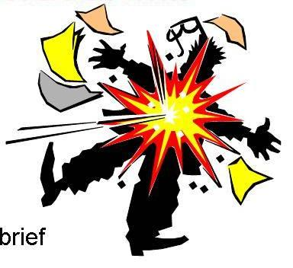
Briefing Suicide
NEVER, NEVER, NEVER
Demean content of the brief
Make excuses for shortcomings
Read your material
Make up an answer during a brief
Introduce new material in conclusion

Slide 47
Don’t Do This!

Slide 48
Summary
Purpose
Types of Brief
Briefing Steps
Common Errors
Graphic, text, presentation

Slide 49
Check on Learning
Q. Name 4 briefing tips
Stay calm and in control; Use notes to stay on track; Speak loudly and clearly; Speak slowly enough to be understood; Change voice for emphasis; Maintain eye contact with audience
Q. Give 3 things to avoid doing during a brief
A. Monotone voice, looking down or away, nervous habits (repeating yourself, using filler words), unnecessary movements, PowerPoint errors (bad font, too many bullets, busy slides)

Slide 50
Questions?

