Slide 1
CYBER SECURITY AWARENESS AND SENSITIZATION FOR DEFMIS PERS
\\
\\
MAJ R W GAKANYI
SOII CYBER INCIDENT RESPONSE
Notes:
Cyber command falls under DMI and we are located at NMCC

Slide 2
QUOTE
\\
\\
“Many things in life can be safely ignored but ignoring Cybersecurity Safe Practices is an open invitation for disaster.” JC Hunter
Notes:
We can not underscore the need for cybersecurity as cyber warfare it recognized as the fifth domain of warfare. We, as the military have a mandate to defend our networks, data, and systems against adversaries just as we defend our land, water and air against external aggression. Cyber attacks could be internal or external

Slide 3
INTRODUCTION
\\
\\
Increased reliance on ICT infrastructure for military operations, running of public and private sectors and civilian use
Emergence of cyberspace as the fifth domain of warfare after land, air, maritime & space creating a new Operating Environment
However, the increased reliance has also led to a new threat landscape to personal and work cyberspaces.
Notes:
<On first point>
Increased use of ICT systems in the military communication, ops like use of drones, intelligence gathering, systems and applications that are used in our day to day tasks, we are therefore a target for cyber attacks.
One of the agendas of the C in C through the ministry of ICT is to see over 5000 govt services digitized and moved to the E-citizen platform.
KDF is the force of last resort, therefore our responsibility spans from protecting our own infrastructure to protecting the national digital infrastructure.
There is therefore need to continuously harden the MOD and national ICT infrastructure and train pers on how to recognize and respond to cyber threats
<on point 2> Unlike the other domains of warfare, cyber is the only domain where all of us are targets or victims, the rich, the poor, the young, old, anybody who owns a phone, any smart device is a target for cyber attack .
For instance DEFMIS generates and handles sensitive information for KDF current and retired personnel. This makes it attractive to malicious cyber actors from State and Non-State actors, cyber criminals and even insider threats. That means cyber security is a concern for all DEFMIS pers and that why we are here.

Slide 4
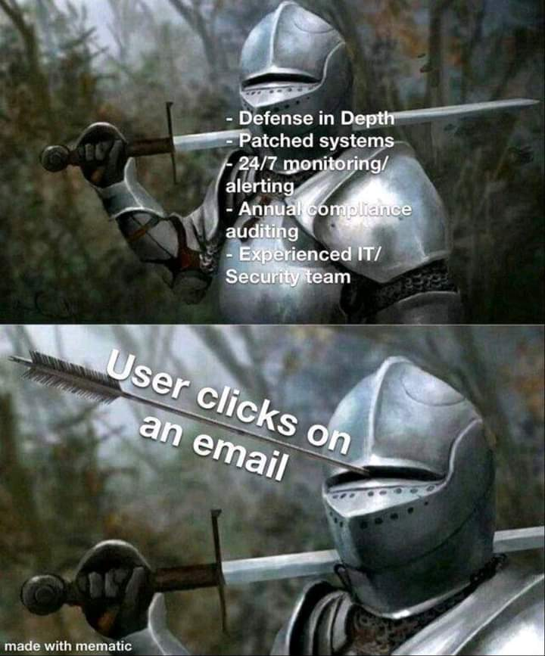
INTRODUCTION Cont…
\\
\\
Human beings are always the weakest link
Notes:
Why training and awereness for DEFMIS? Why don’t we have robust monitoring and protection systems like antivirus, incident detection and prevention tool? Users are always the weakest link even when all technical, physical and logical controls have been put in place. It takes a user to click on a malicious link, to plug an infected USB, to connected to a rogue access point at café, airport

Slide 5
AIM
\\
\\
To create awareness to DEFMIS staff on cyber security hygiene measures for a safe and secure DEFMIS ICT environment

Slide 6
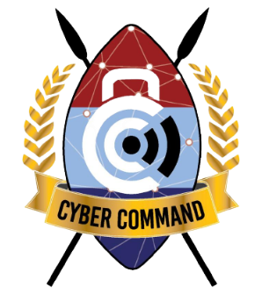
SCOPE
\\
\\
What is cybersecurity
Need for Awareness Training
Most Prevalent Threats
Identifying Compromises
Best Practices
Q&A

Slide 7
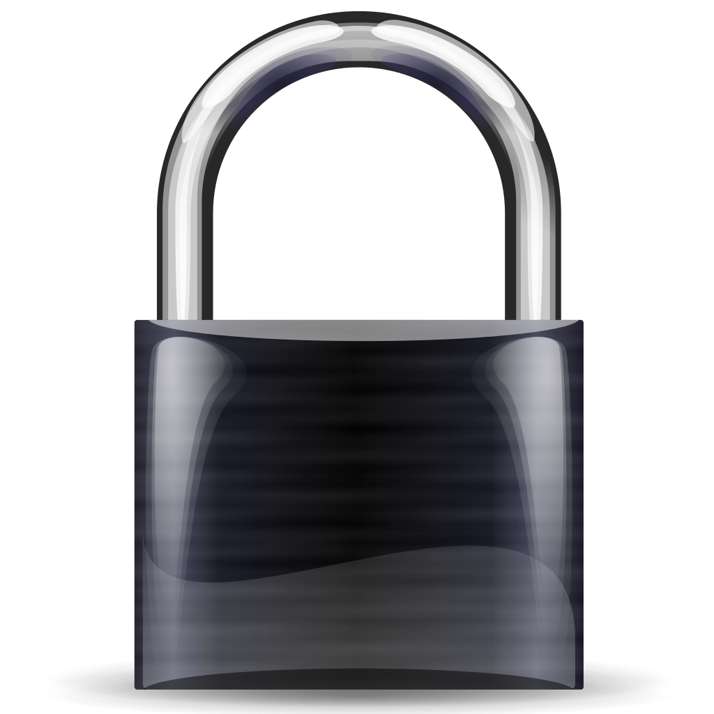
CYBERSECURITY
PEOPLE
PROCESS
TECHNOLOGY
Cyber Security
Comprises technologies, processes and controls that are designed to protect systems, networks and data from malicious acts undertaken via cyber-space such as attacks, damage or unauthorized access.
Roles & Responsibilities
Cyber culture
Training
Incident Detection
COTS
Policy
Standards and Guidelines
Threat Intelligence
Forensics
Assessment
Architecture
Notes:
Cyber security Cyber security is a subset of InfoSec, that focuses on protection of computer systems and their components including hardware, software, data and digital infrastructure (from unauthorized use or harm), effectively to provide components e.g. CIA
InfoSec refers to the practice of preventing unauthorized access, use, disclosure, disruption, modification, inspection, recording or destruction of information.
People – are the people in key responsibilities like network, sys admins competent
Are your users trg
What is your cyber culture? How do you do things related to cyber?
Technology- what technology do you have in place? Firewalls, ids, ips
Process- Process refer to the procedures and protocols put in place to manage cybersecurity effectively.
Do you have a cyber policy? Std and guidelines?
These are documents outlining the rules and guidelines for securing an organization's systems, networks, and data. They provide a framework for implementing and enforcing cybersecurity measures effectively.
What does your cyber policy say about for risk assessment?

Slide 8
CIA TRIAD
\\
\\
Notes:
Cybersecurity is about protection the confidentiality. Integrity and availability of data
DDOS attacks affect the availability of data. Example the eCitizen case, pple were unable to access the govt service

Slide 9
WHY CYBER SY AWARENESS
Technology alone *cannot* protect you from everything
Attackers go where security is weakest
People -> a link in the chain & the first line of defence
A must to reduce cybersecurity risk
Cybersecurity awareness is for...
Employees
Business owners
Reminder: Many tips that keep you safe at work will also keep you safe at home!
Parents
Kids
Seniors
Everyone!
Notes:
There is a common belief that our IT department will take care of it or a firewall and anti-virus will protect us against anything. We are wrong coz
Cybersecurity awareness is a must for everyone!
Practice the safe measures at work at home with your family, a compromised device in a home network cld introduce vulnerabilities to a work network

Slide 10
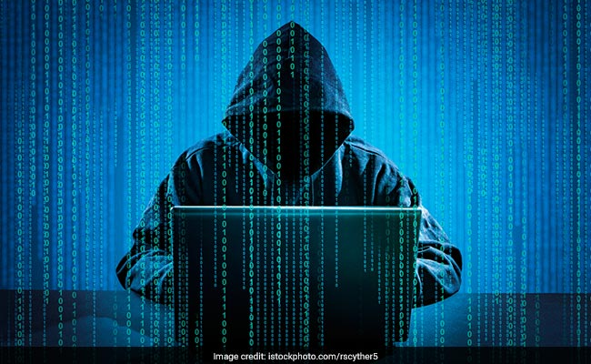
KEY & EMERGING THREATS TO DEFMIS
\\
\\
Malware
Ransomware
Trojan
Worms
Business Email Compromise
Social engineering: phishing, vishing, smishing
Insider threat
Third party exposure
Notes:
We have looked at why we need cyber security awareness , now let us look at what threats we are prone to as users of technology
Malware are malicious software intentionally designed to cause damage to a computer, server, client, or computer network.
Ransomeware- attacker encrypts your data and demands a ransom for you to have your data back
Trojan- malicious software that Pauses as legitimate software or hidden with legitimate software
Worms- Self-replicating programs that spread independently across networks, without needing to attach to a host program
Social engineering- Attacker exploits human psychology and emotions to deceive targets and make them disclose confidential information
Threats introduced by third parties eg third parties can include vendors, service providers, contractors, partners, or any external organizations that have access to the organization's data, systems, or networks.

Slide 11
KEY & EMERGING THREATS TO DEFMIS Cont.…
\\
\\
System vulnerabilities & misconfigurations
Missing updates and patches
Denial of Service attacks
Frauds, credit card frauds, identity theft
Compromised credentials
BYOD
Notes:
Our monitoring tools detect a lot of DPAY leaked credentials, username and password that could be used to compromise our systems
Compromised devices are plugged on to our corporate networks

Slide 12
IDENTIFYING COMPROMISES
Antivirus software detects a problem
Disk space disappears unexpectedly
Pop-ups suddenly appear, sometimes selling security software
Files or transactions appear that should not be there
Own account lockout
Notes:
What are the common indicators of compromise

Slide 13
IDENTIFYING COMPROMISES Cont.…
The computer slows down to a crawl
Unusual messages, sounds, or displays on your monitor
The mouse pointer moves by itself
The computer spontaneously shuts down or reboots

Slide 14
WHAT TO DO WHEN COMPROMISED
When you suspect a breach:
Do not panic
Contact IT Pers
Disconnect network cable
Do not switch off the computer
Do not tamper with the storage drive

Slide 15
CONTACT INFO
Contact Cyber Sub-Branch Email: incidents@mod.go.ke cyberdo@mod.go.ke Ext: 4400/5440/5441

Slide 16
KEY CYBER HYGIENE MEASURES
\\
\\
Ensure sensitive data is encrypted in motion and at rest
Update and upgrade your systems and softwares to the lates version
Notes:
what was secure yesterday may not be secure today. We have vulnerabilities & malwares being discovered on a daily basis approx. 360k. As Cyber Branch we have daily and weekly CTI reports on these and we also issue advisories on the same.

Slide 17
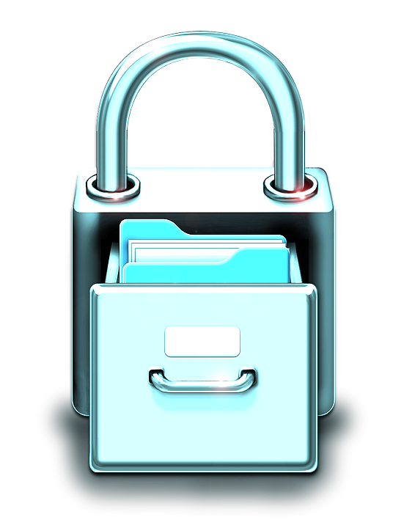
PASSWORD BEST PRACTICES

Slide 18
PASSWORD TIPS
Avoid using items that can be associated with you
Address
Phone numbers
Pet names
Separate passwords for every account
Auto-generated, unmemorable
Child names
Birthdays
Sports teams
Possible with a password manager
69%
95%
59%
86%
Passwords shared with colleagues
Passwords shared with household
One password for all accounts
Passwords are too “simple”
Notes:
Some tips about passwords, ensure you don’t use that little dogs name, we don’t want to rename him…

Slide 19
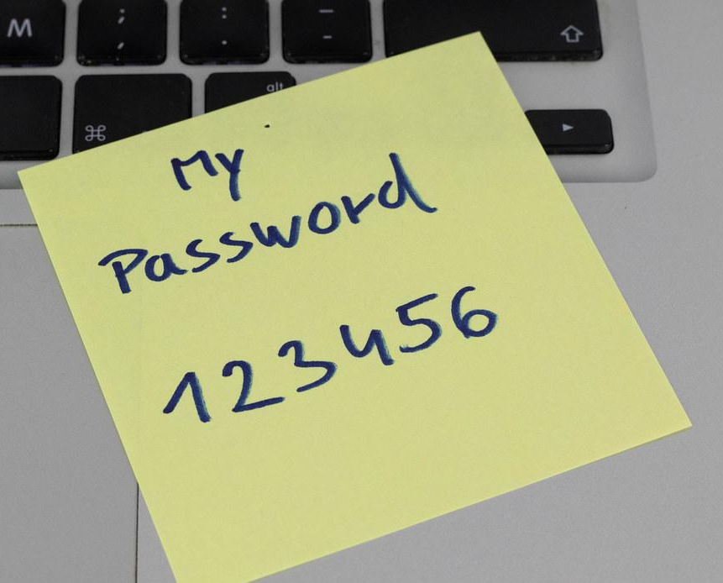
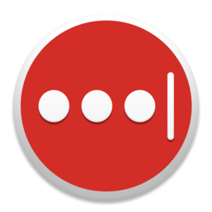
MANAGING PASSWORDS
Keep your passwords in a secure location
Don’t use paper or sticky notes
Don’t store passwords in clear-text on your computer - Word, Excel, etc
Don’t save your passwords on the browser
Utilize a password manager (aka vault)
Benefits of a password manager
Single strong password to remember them all
Encrypted storage of passwords
Auto-fill username/password on websites
Secure password sharing
1Password
Notes:
How do we manage our passwords. Keep your passwords in a secure location…
Password managers: bitwarden, keeper, lastpass, 1pass
We have some free password managers… The benefits of a password manger is that we can use a single strong password to remember all our passwords and encrypts them

Slide 20
PASSWORDS VS PASSPHRASES
Useful when passwords must be typed in
Should not be easy to guess
At least 12 Characters, but 15 or more is far better
Length is better than complexity (passphrases)
Bad password (8): P@ssw0rd (meets all psswd complexity)
Great password (24): MysonwasbornNovember1995!
61%
9.6
6.1
0.2
Passwords exactly 8 characters
Average Length of Password
Average number of lowercase letters
Average number of special characters
Notes:
Passphrases are long easy to remember passwords. We use them where we actually need to remember the password e.g. login to your computer or accessing your password manager…..
When it comes to passwords lengthy passwords are more secure than short complex passwords. P@ssword Meets al the complexity in the world yet it is a weak password.
Can you remember a 24 character password?

Slide 21
TOP 25 PASSWORDS BY RANK & YEAR
If you use any of these, change them NOW!!!
Source: Gizmodo
Notes:
8Xter pwssd, standard comp year, GPU, supercomputer, botnet will take 5 days. 10xter-4 months, 11xter 10years, 12xter 20yrs, so what about a 24xter???

Slide 22
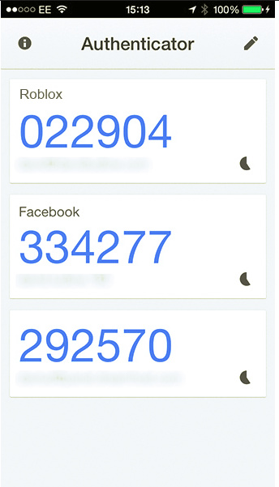
2FA - TWO-FACTOR AUTHENTICATION
What is 2FA?
“Beyond” a username and password
Second form to prove it is you
Typically out-of-band
“Your one-time code is…”
SMS
Phone Call
Phone pop-up
Applications
Google Authenticator
FreeOTP
Email
Snail Mail
Notes:
There are multiple (3) factors to authenticate (MFA) to a system. Ie
Something your are (biometric authentication)- finger print, iris scan, face ID
Something you know (Knowledge based auth)- PIN, password, passphrase
Something you have(possession based auth)- smartphone, token, smart card, or hardware security key

Slide 23
WHAT’S YOU PASSWORD?
Notes:
This is how easy it is to get passwords from users. Most users use one password for different accounts

Slide 24
SOCIAL ENGINEERING
Notes:
This is how attackers could use social engineering to gain access to our data in trusted institutions like bank
Would you fall for this?

Slide 25
LINKS BEST PRACTICES

Slide 26
JUST A LITTLE CLICK
Notes:
One of the most common ways/techniques that attackers use to trick victims is by use of links. The links could be sent thru email, SMS or social media accounts.
You are a click away from a cyber attack. Phishing attacks are perpetrated through malicious links at attachments send to targets. It is therefore important to know how to distinguish a genuine link from a malicious one. If you are not sure, don’t click

Slide 27
Is the link safe in 4 steps
LINK SAFETY
1. Verify
4. Click
Were you expecting to receive a link?
Not just email!
Social Media
SMS/iMessage
04
If it passes the three previous tests, it should be okay to browse to
3. Sniff test
01
03
2. Hover
Is it a site you recognize?
Does it feel “familiar” to you?
Be sceptical
Hover over the link to ensure that it leads where it says it does
02
Notes:
Essentially there are four steps to go thru when checking if a link is valid. We will dive deeper into each of the steps in coming slides

Slide 28
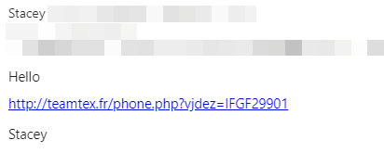
Known email account
EXAMPLES
Hacked or spoofed email from someone you know
Red flags?
Email address ok
Name ok
Flagged/Odd “signature”
Expected email?
Link - .fr is France
Notes:
Are there identifiable red flags on this email?
We will use a systematic approach trying to look for the red flags
This is a hacked or spoofed email from someone you know. Spoofing is the act of disguising a communication from an unknown source as being from a known, trusted source

Slide 29
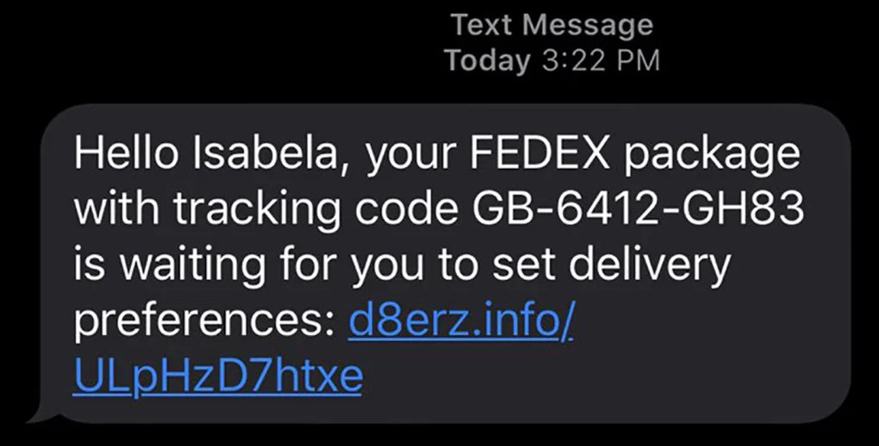
Text messaging example
EXAMPLES Cont……
Source: CNN
Red flags?
Name in SMS ok
Number ok?
Expected text?
Received a text regarding a package before?
Recognized domain?
Notes:
Switching gears a little bit. This is a text msg. These kind of texts are usually common “guys from Kamiti”

Slide 30
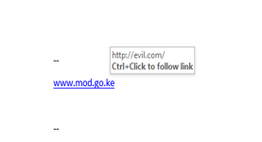
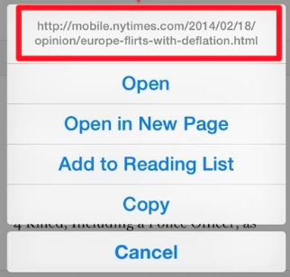
Hover before you click
Why hover?
Blue text can be deceiving Underlying URL may be different
Foreign domains - .uk, .cn, or .ru
Numbers instead of letters
Example: 192.168.1.1
Don’t trust it!
Hover on mobile/tablet?
Long press (hold)
Any doubts? Don’t click it!!!
EXAMPLES Cont…
http://www.evil.com/
Notes:
Desktop – Hover
Mobile - Long Press
Before you click on any sent link, always hover on it…. The blue text can be deceiving. For mobile phones if you can’t hover, examine the link on another device e.g. desktop
Desktop - Hover

Slide 31
Shortened or obfuscated links?
Instead of 300 characters, the link is reduced to 15 characters
Bit.ly
TinyURL
Extremely common and helpful, but... Abused by criminals to hide malicious websites
EXAMPLES Cont…
Link expander www.linkexpander.com
Notes:
These are extremely shortened links. These technique is very helpful technique when browsing but then it can as well be abused by criminals. Even if you were to hover on it… it will just show the same Bit.ly. There are tools for expanding this kind of URLs, some even do it online….

Slide 32
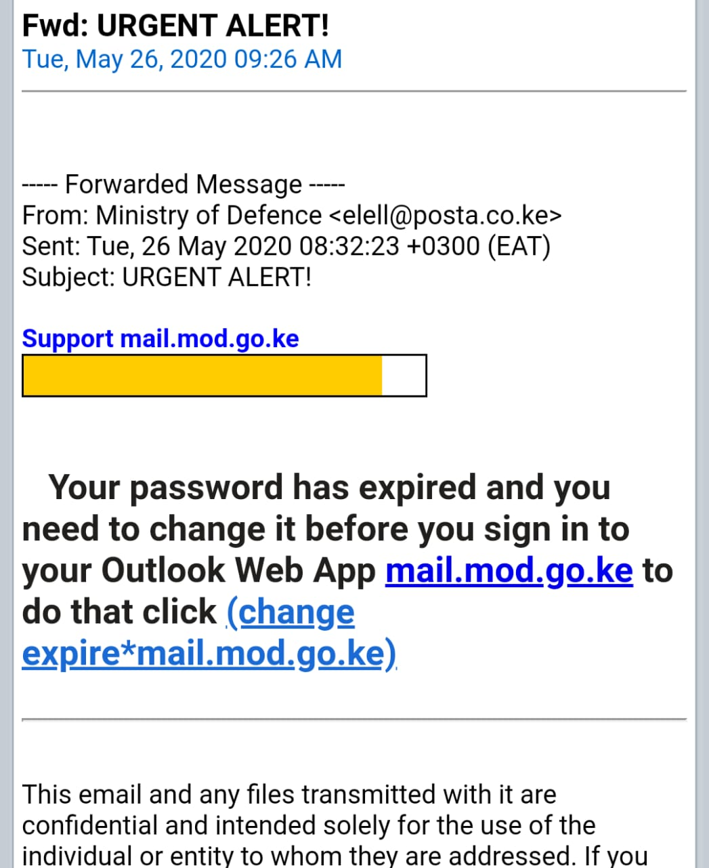
EXAMPLES Cont…
Notes:
This is an example of an actual email that was received. Lets have a look at it together. Can we identify any triggers. Email address, Outlook web app, hover on the link, urgency. In this case what do you do? Call cyber support

Slide 33
EXAMPLES Cont…

Slide 34
EXAMPLES Cont…
Notes:
The email addresses a fake support@rnicrosoft.co.uk and a real support@microsoft.co.uk
2. ⁠the subjects, fake states an Urgent action Needed while the real Unusual sign in activity
3. ⁠the real support mail gives a user email within its body while the fake one doesn’t
4. ⁠the fake email gives a reset password .aspx link that looks suspicious while the real email asks you on a highlighted text shortening to review recent activity link

Slide 35
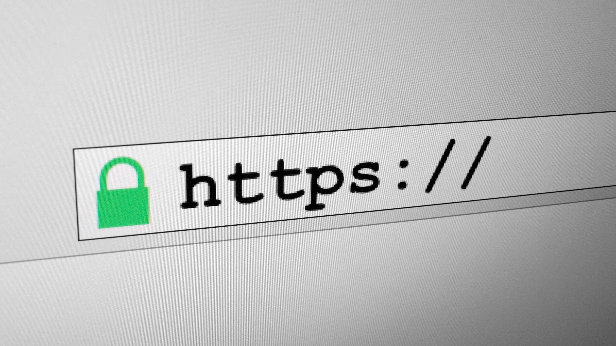
INTERNET SAFETY QUICK TIPS
Never install anything based on a pop-up when visiting a website
“Trusted” websites can & have hosted malware, aka malvertising
Limit browsing to work related sites
Check for spelling mistakes in URL
Ensure no one is shoulder surfing
Never use referral links to visit a website
Do NOT assume a site is legitimate simply because of the green padlock
Notes:
Links without a padlock icon, and with HTTP and not HTTPS on the URL could be malicious. However, the padlock doesn’t mean that necessarily a site can be trusted, what it means is that data exchanged between you and the site is fully encrypted. The link should be probed further.

Slide 36
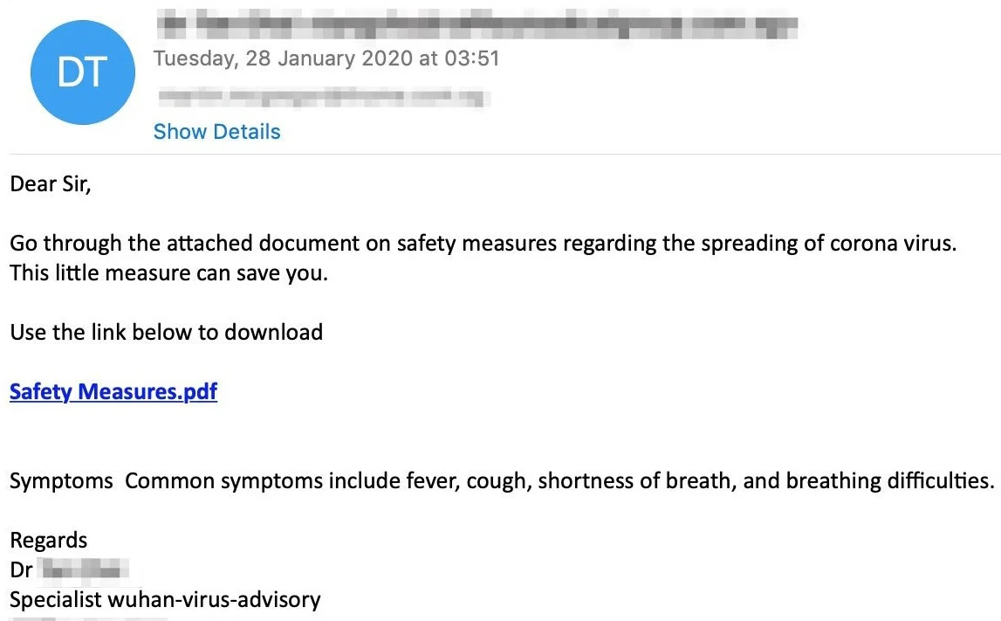
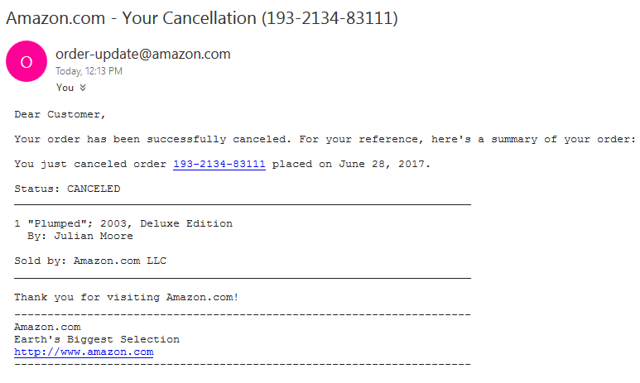
SCAMMER FAVORITES
Recent events - coronavirus
Mimic recent news
Worldwide
Health scares
Sports betting
Elections
Local and regional
Seasonal/holidays
Order & delivery issues
Tax issues,KRA- June
Do not click, download or open such attachments, confirm signature
Order Cancelled
Notes:
Attackers will look for anything that will prompt you to click on the link

Slide 37
SOCIAL MEDIA
Social Media (FB, Tiktok, Whatsapp X.) is now an integral part of us
Be sensitive on what you upload (status, pics)
Don’t overshare e.g. vacation photos
Keep your personal details personal, DoB, Tel
Use security and privacy options provided
SMS based MFA/2FA
Access control (who can see what) Browser/machine mapping to your social media acc
Block
Notes:
Keep your private life off social media,
Do not post your children’s, spouse photos, names, birthdays, schools, residential areas, jogging tracks, plates of vehicles you use
Social media does not forget

Slide 38
CONCLUSION
You are the best defence!!
Technology is only a small part of Cyber Defence
You are the most important person – protect yourself
For organisations the most important and best defence is Cyber Security Aware employees – train your staff
Always be aware!
Always be on your guard!

Slide 39
Q and A

